Slide 1

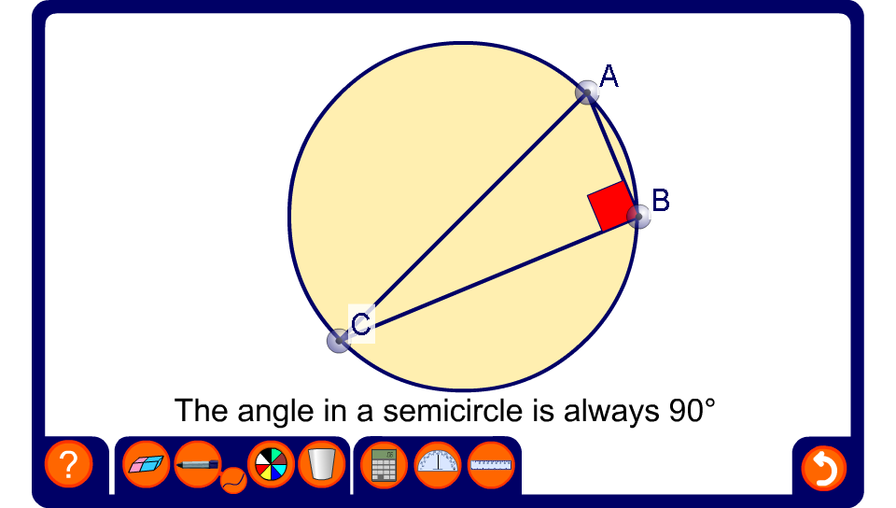


Right angles in a semicircle
Notes:
Drag the points around the circumference of the circle to demonstrate this theorem.

Slide 2
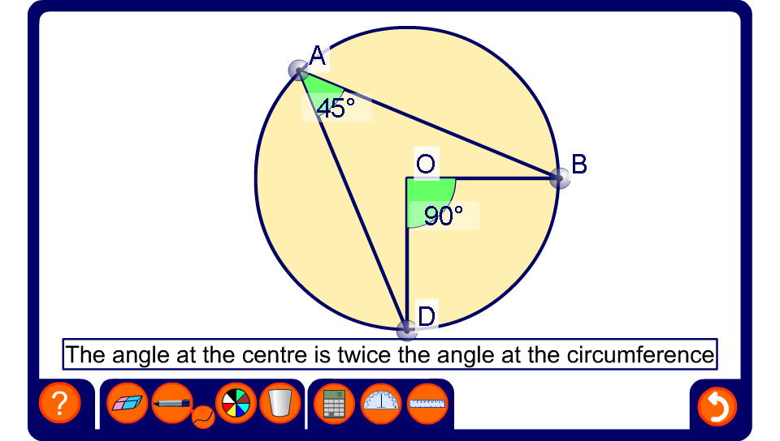
The angle at the centre
Notes:
Drag the points around the circumference of the circle to demonstrate this theorem.
Hide one of the angles, modify the diagram and ask pupils to calculate the size of the missing angle. Be aware that the angles have been given to the nearest degree.

Slide 3
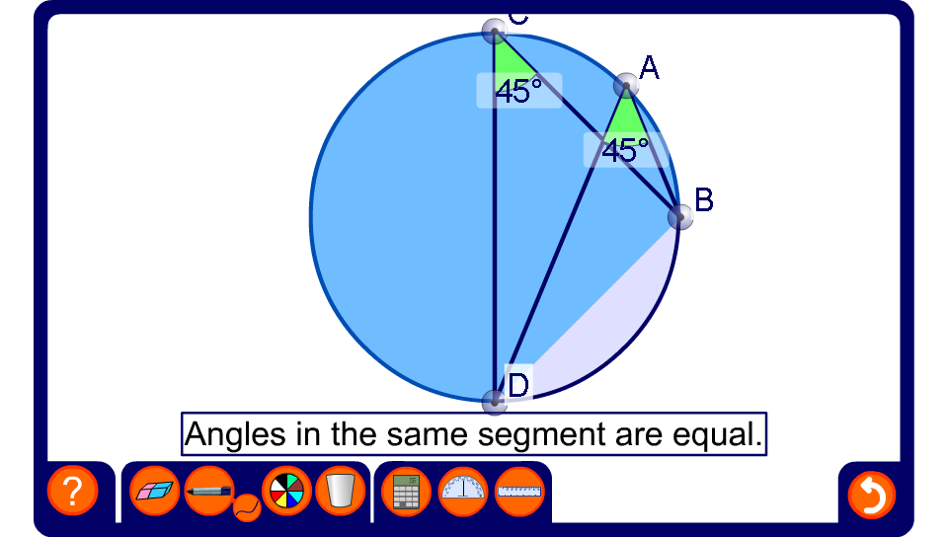
Angles in the same segment
Notes:
Drag the points around the circumference of the circle to demonstrate this theorem.
Hide one of the angles, modify the diagram and ask pupils to calculate the size of the missing angle.

Slide 4
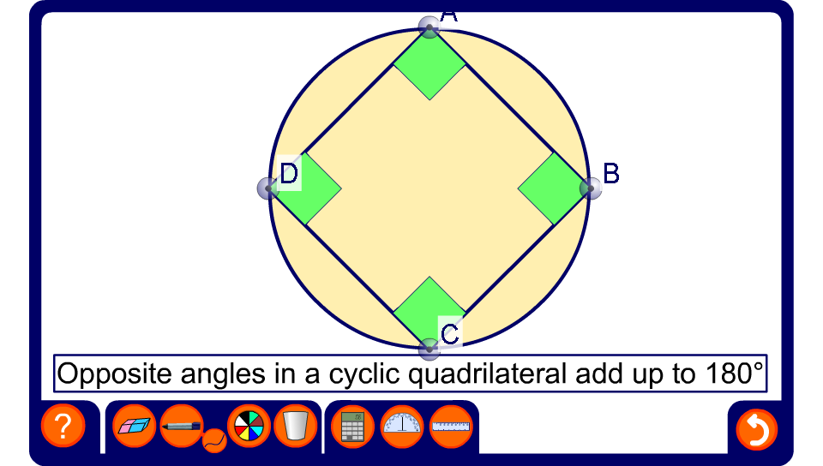
Angles in a cyclic quadrilateral
Notes:
Drag the points around the circumference of the circle to demonstrate this theorem.
Hide some of the angles, modify the diagram and ask pupils to calculate the sizes of the missing angles.

